Slide 1
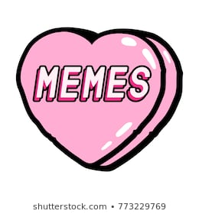
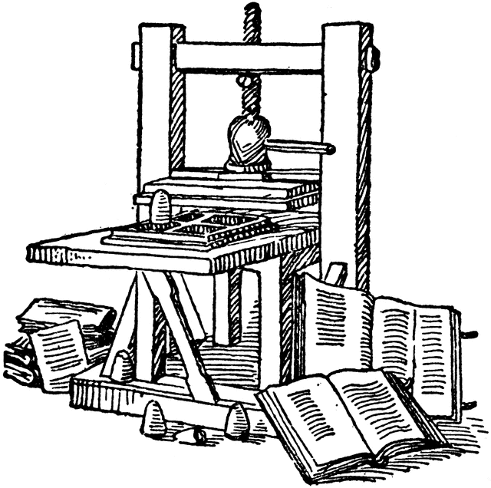
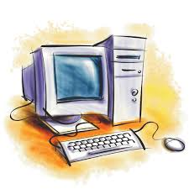
From Newspaper Cartoons to Tiktoks: The Evolution of Political Satire
Presented by: Kristin D’Angelo

Slide 2
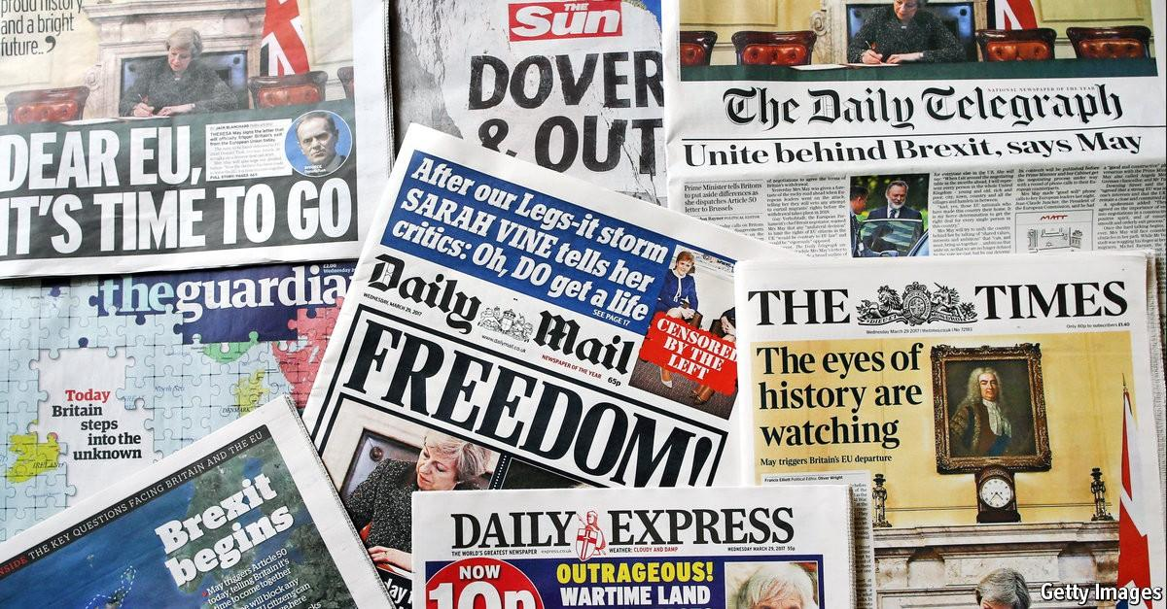
Who knows what a newspaper is?
Who knows what a newspaper is?
Who has read a newspaper before? Who has a newspaper subscription?

Slide 3
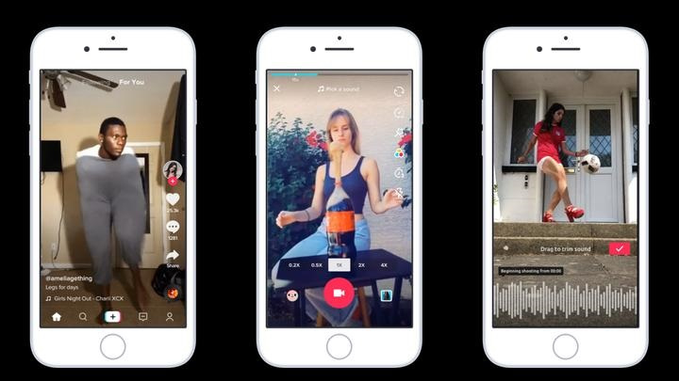
Who knows what “Tiktok” is?
Who uses Tiktok?

Slide 4
What is Political Satire?
Wikipedia says:
“Political Satire is satire that specializes in gaining entertainment from politics”
(having both the words “politics” and “satire” in the definition aren’t very helpful)
Translation: sarcastic criticism aimed at current events or political officials; ironic humor for the purposes of improvement or correction
Aka pointing out what you think is wrong but in an indirect, passive-aggressive way
Another definition, courtesy of Wikipedia:
“It has also been used with subversive intent where political speech and dissent are forbidden by a regime, as a method of advancing political arguments where such arguments are expressly forbidden”
Translation: rebellion!

Slide 5
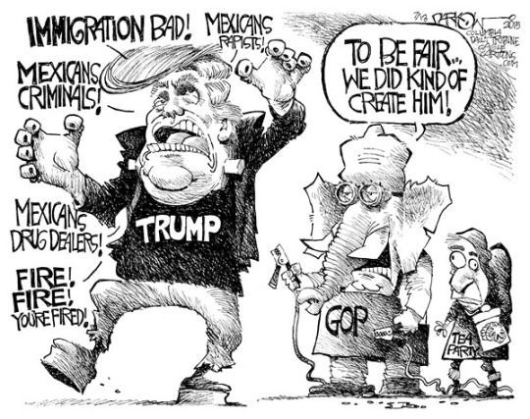
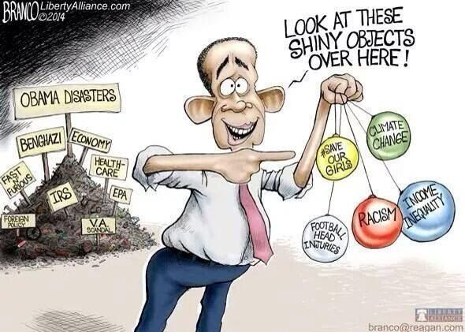
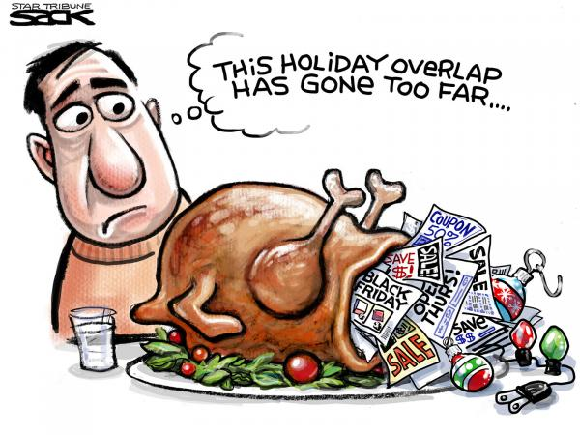
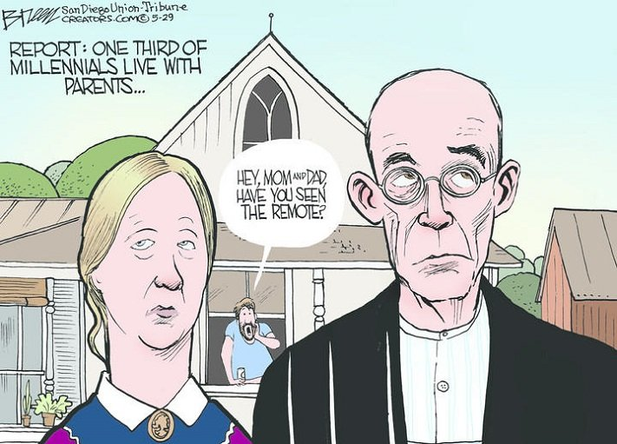
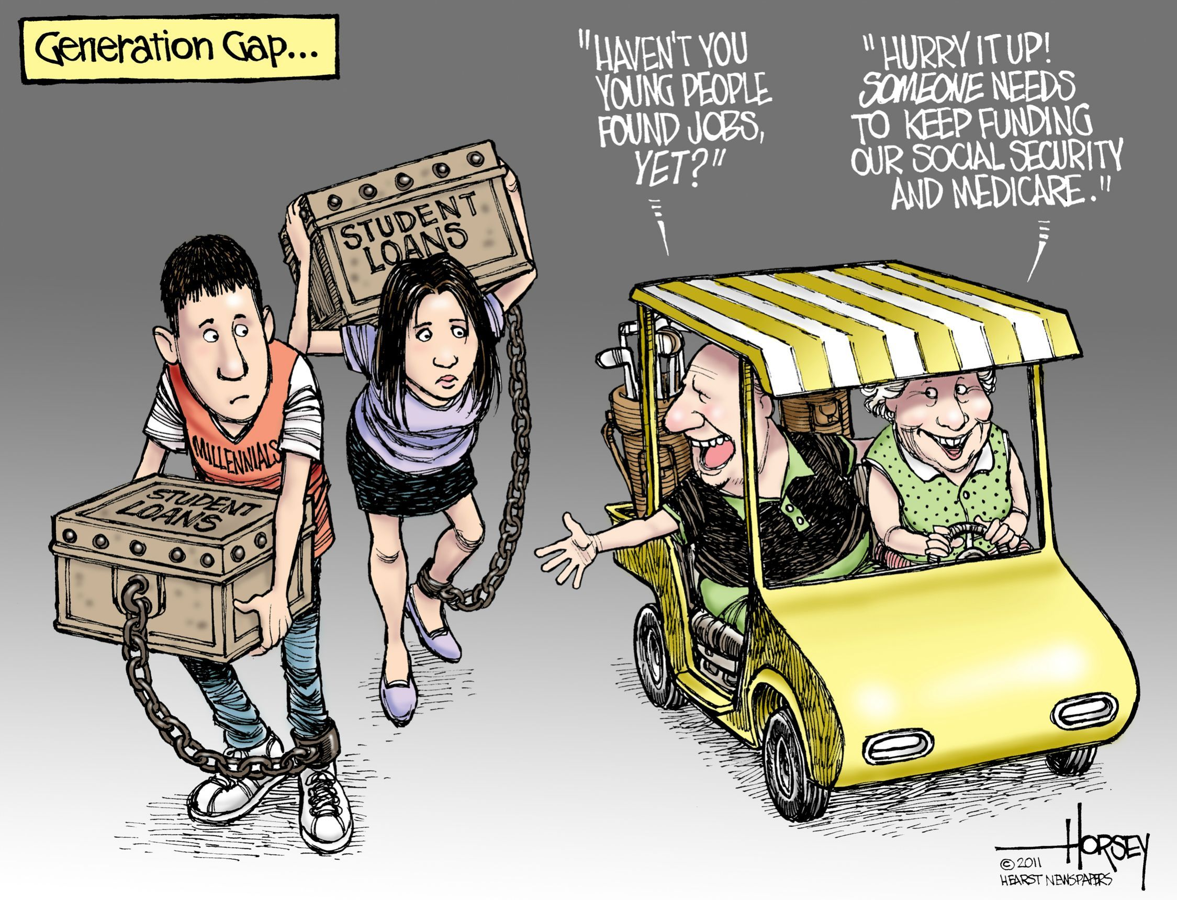
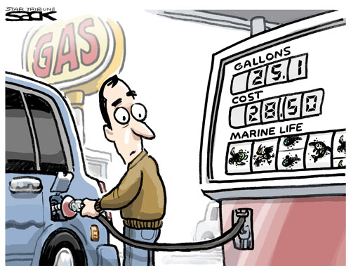
Political Satire is not restricted to:
A single issue...
A single party...
A single generation...
Notes:
Even though it’s “political satire”, can be about environmental issues, international relations, the economy, cultural taboos, etc - have some relation to politics
(ex. What is this one about? the environment and economy)

Slide 6
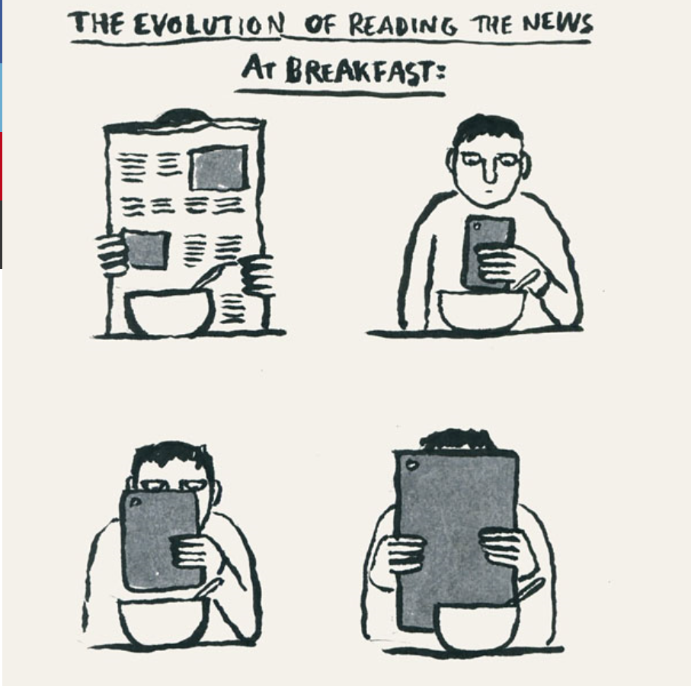
So how did we go from newspapers to tiktoks?

Slide 7
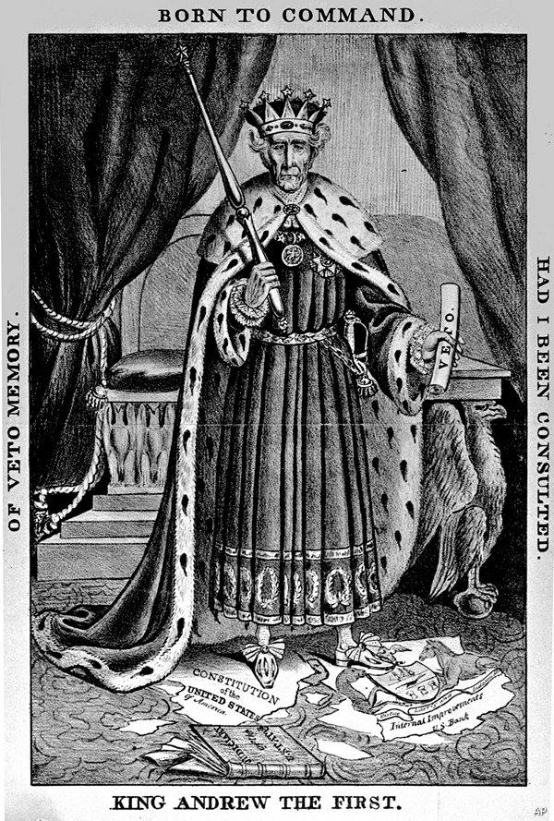
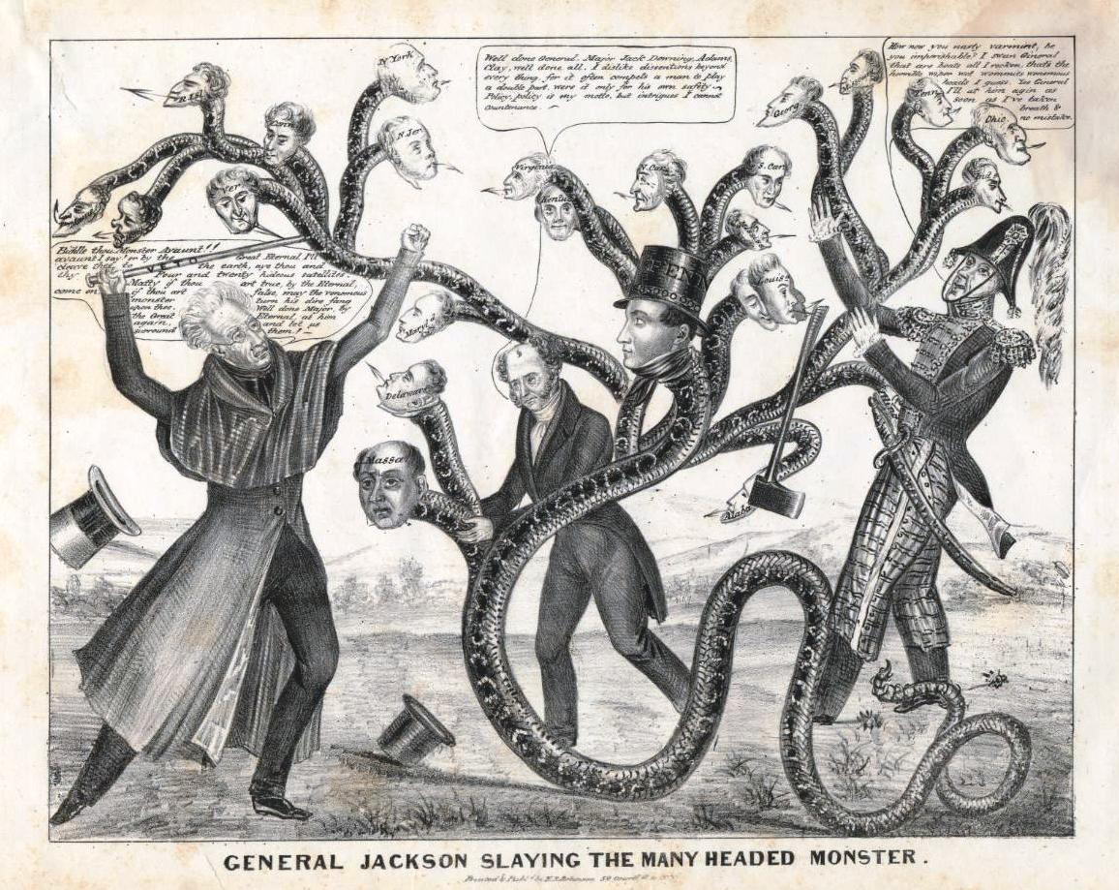
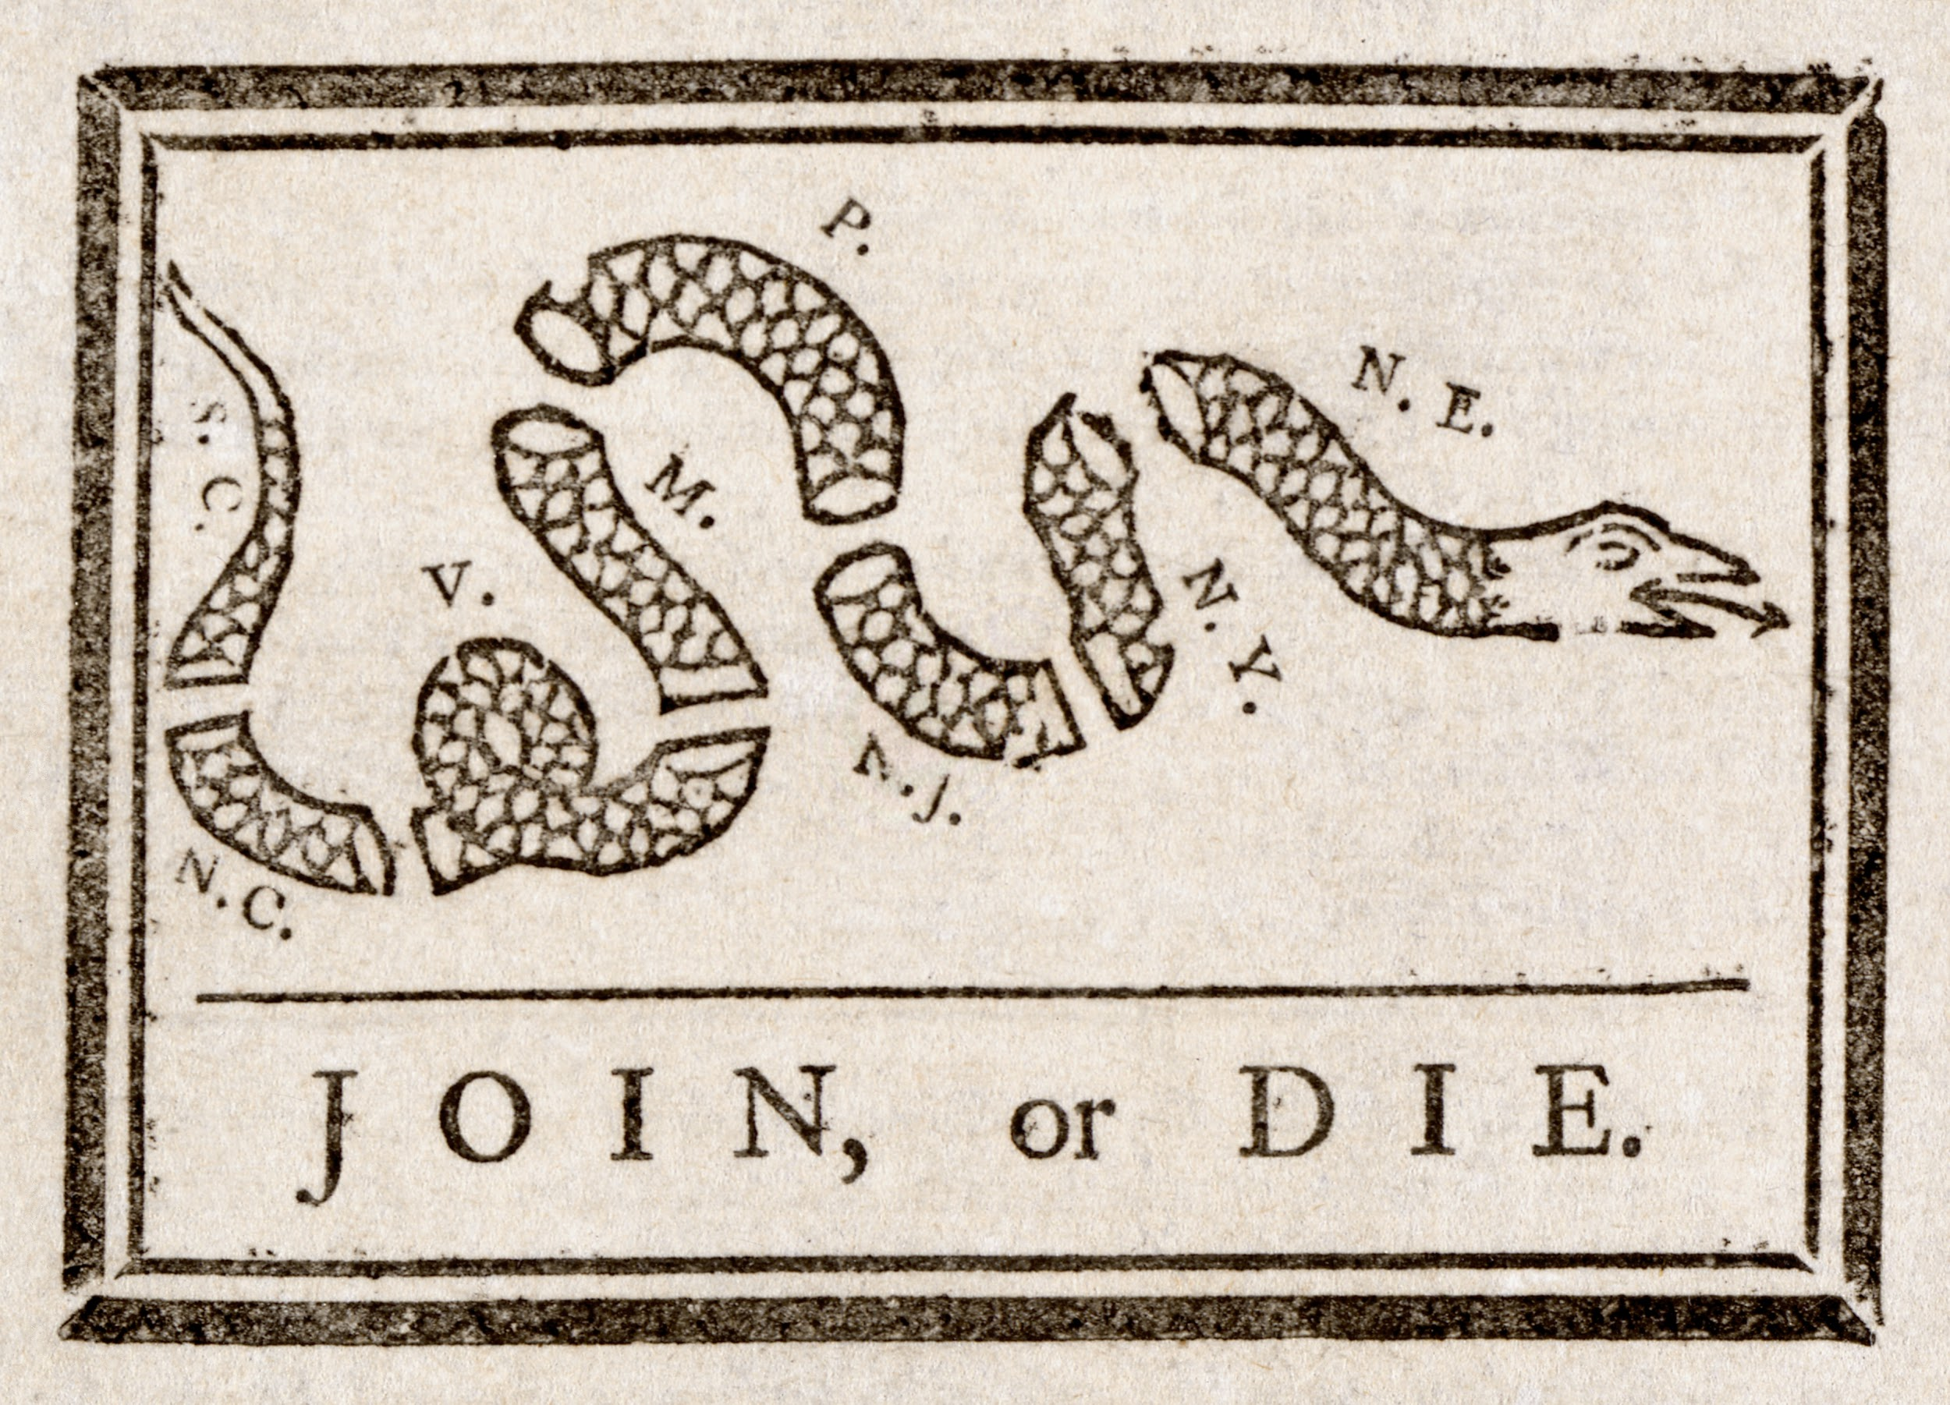
Examples of political satire you may encounter in your history or government classes in high school:
“Jackson slaying the many headed monster” (1836)
“King Andrew the First (1833)
Benjamin Franklin’s cartoon Join or Die, first published in The Pennsylvania Gazette in 1754

Slide 8
Those are pretty old though, so let’s look at something a little more modern...

Slide 9
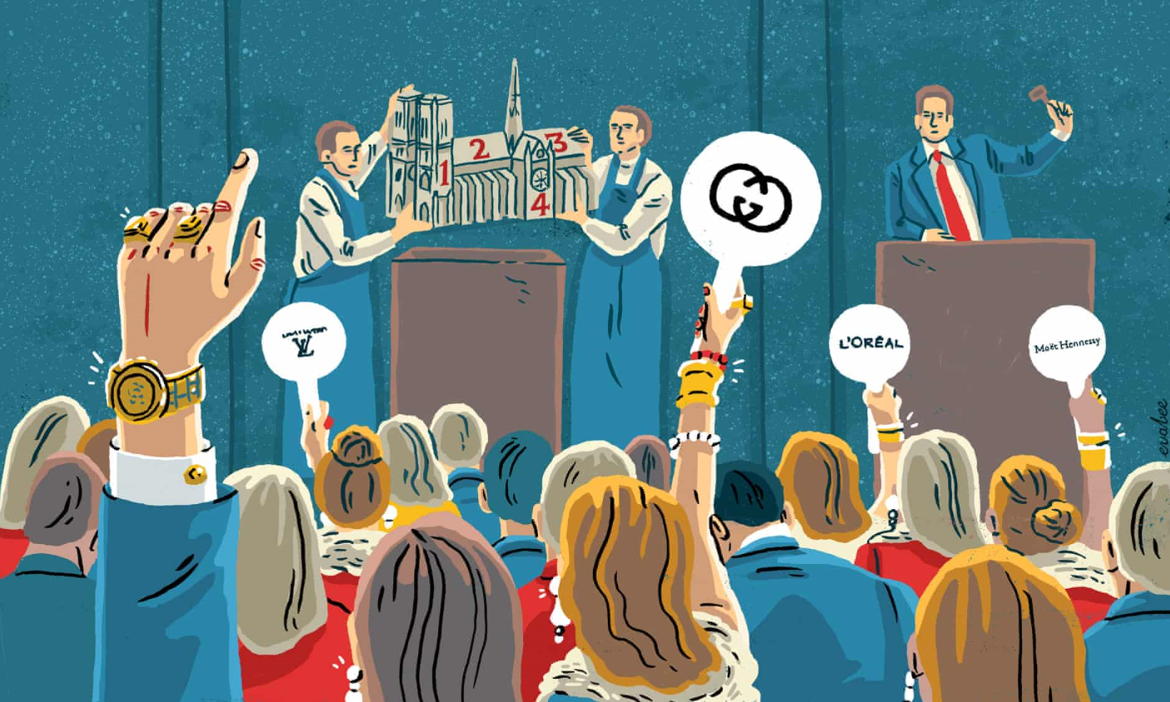
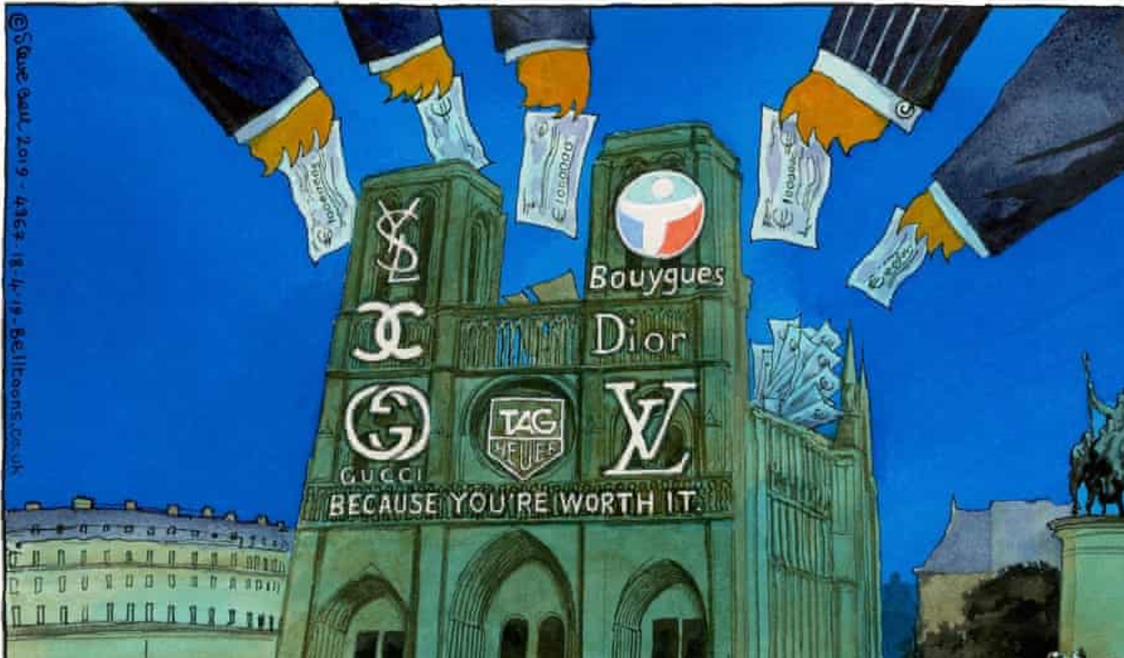
So newspapers reported on this, but not only articles, but political cartoons as well
https://www.theguardian.com/commentisfree/2019/jul/18/ruins-notre-dame-billionaires-french-philanthropy
Eva Bee from The Guardian
Steve Bell from The Guardian

Slide 10
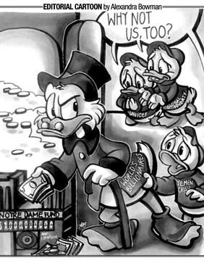
College kids got in on it
The Hoya, the Georgetown University newspaper of record
Political satire can make references to other events and/or pop culture

Slide 11
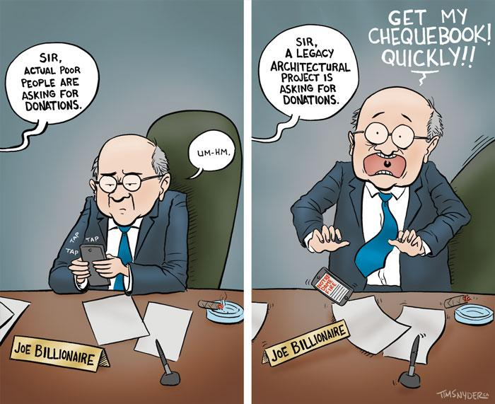
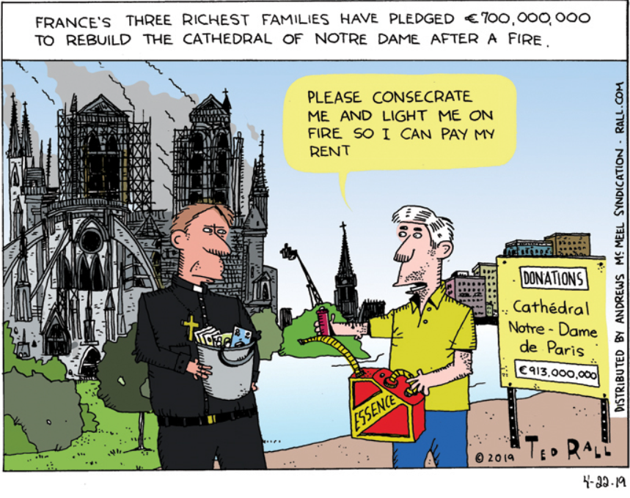
To younger people running blogs online and posting their own political cartoons
Similar to political cartoons in newspapers, except criticism isn’t only limited to professional journalists - any nonreporter person can express their opinion
Onset of the internet and digital media (blogs) allowed for more people to participate in political satire
https://tonup.ca/cartoons/page/3/
https://rall.com/tag/cathedral

Slide 12
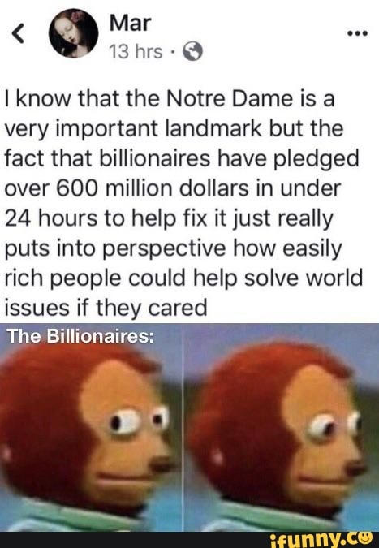
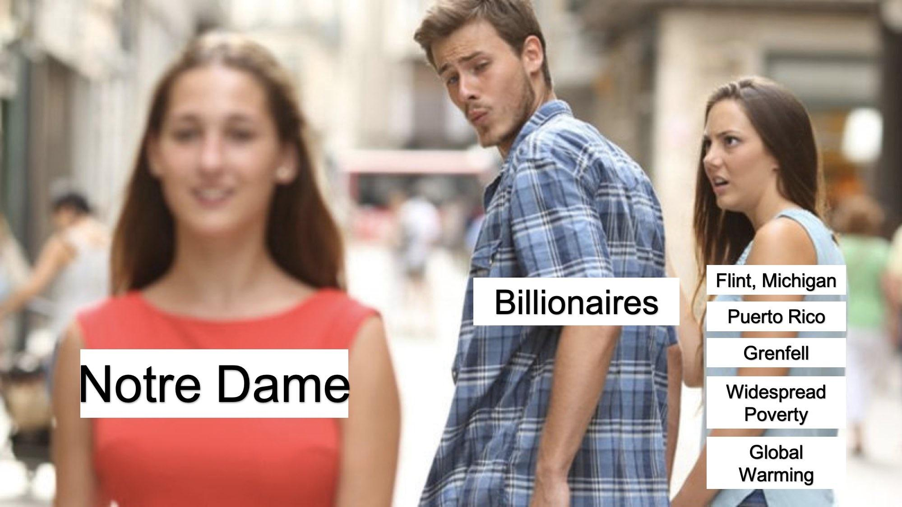
To memes (similar to political cartoons)
Social media further extended political satire:
Made it accessible to more people and younger audiences
Pictures with short text messages convey an opinion or point
Easily shared

Slide 13
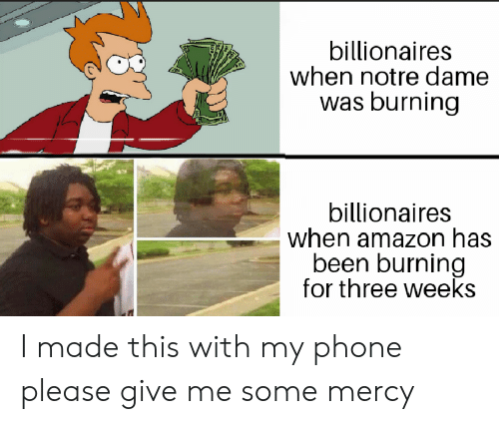
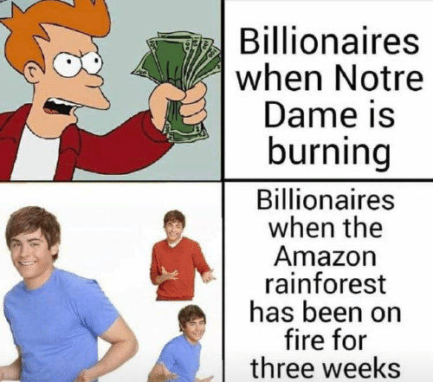
People with the same opinion can express their agreement (or qualms if they disagree) by commenting, liking, and sharing posts
People can even share a similar meme with a similar message but personalize it

Slide 14
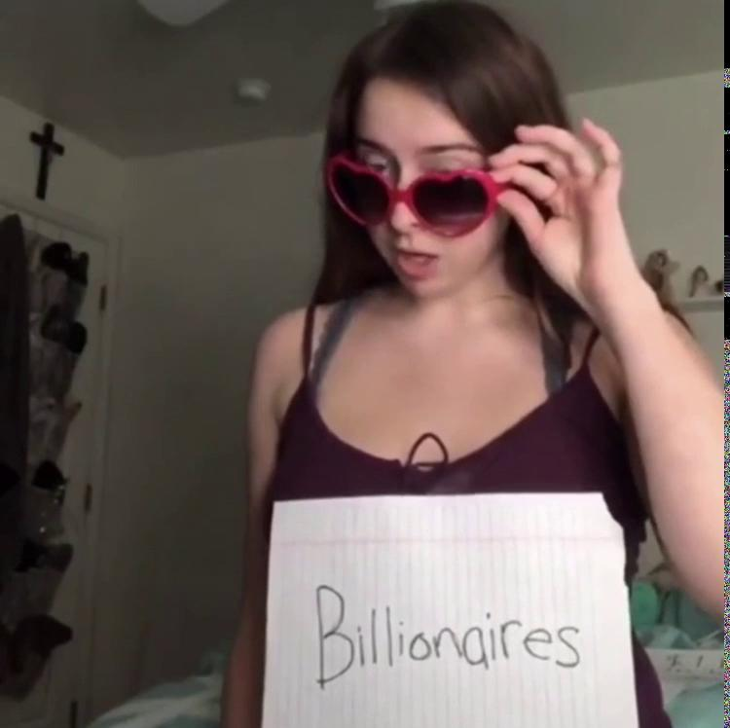
Digital media not only enables pictures to be shared, but also videos
Can share videos on instagram or twitter
Vine and tiktok are (well were) notorious video-sharing platforms
It’s not just adults who see the absurdity of the situation
Kids do too!

Slide 15
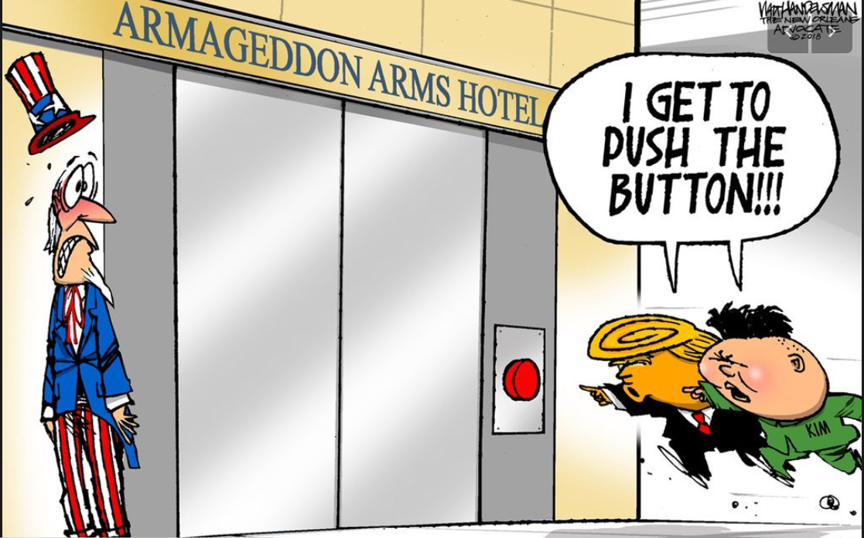
Key: taking serious topics and inserting humor into them to try to get a message across
It would be kind of bad if one of them actually pushed a button to launch nuclear missiles

Slide 16
Like, really bad...

Slide 17
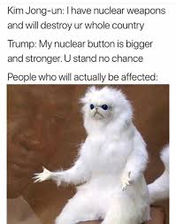
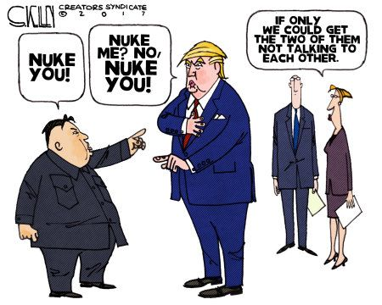
People do seem to understand that though
But they can’t help but put a little humor into a serious situation

Slide 18
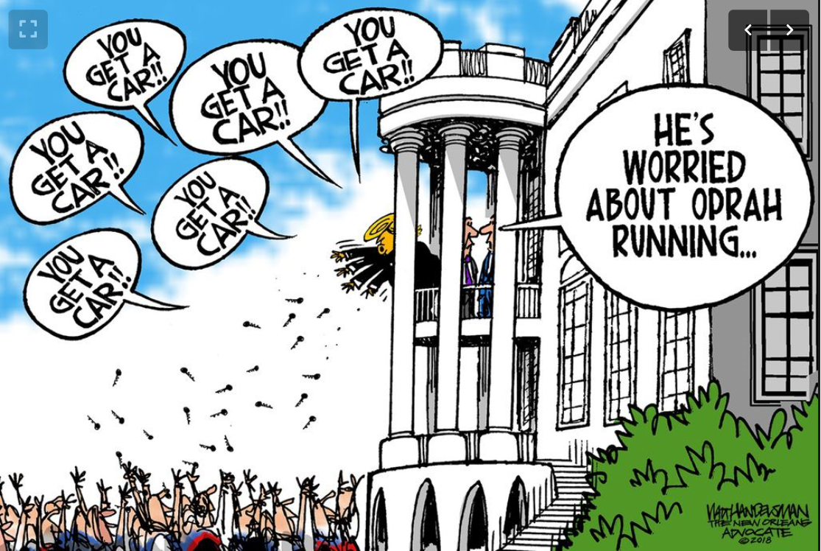
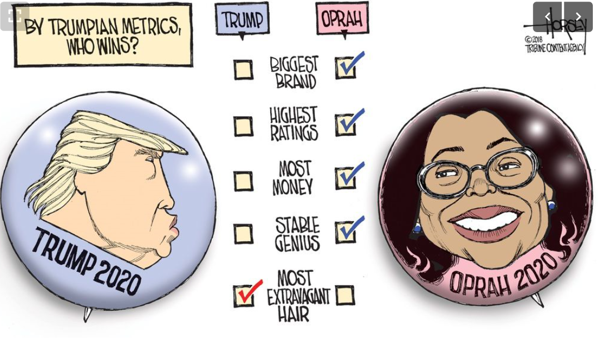
Sometimes they’re more for comedic sake
Unlikely Oprah would run
More aimed at making fun of the president

Slide 19
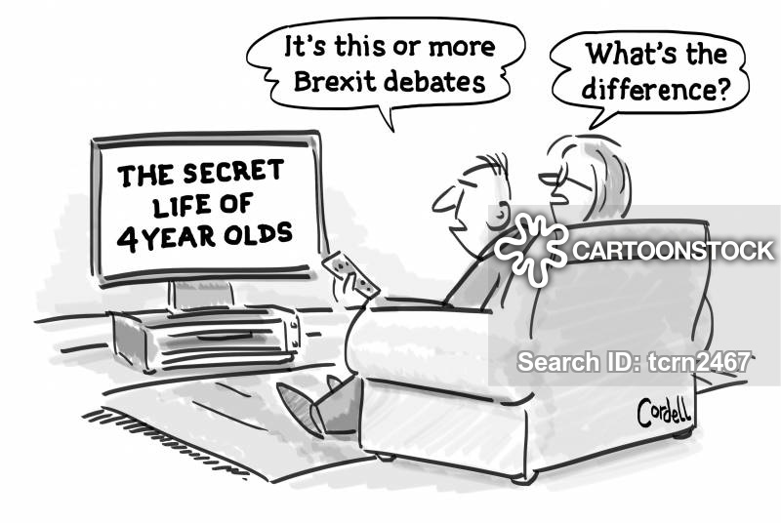
What is the message this political cartoon is trying to convey?
The man thinks 4 year olds are annoying and wants to watch Brexit instead
The man thinks Brexit is annoying and wants to watch 4 year olds instead
The woman thinks 4 year olds interacting and Brexit debates are the same thing because Brexit lawmakers are 4 years old
The woman thinks 4 year olds interacting and Brexit debates are the same thing because Brexit lawmakers are acting like children
Answer: d
Notes:
This is an example of political satire not directed at US government (in this case, British government)

Slide 20
But they cover a whole span of topics
Let’s look at a few
Environmental issues
Medicine
Internet
Food
Generations

Slide 21
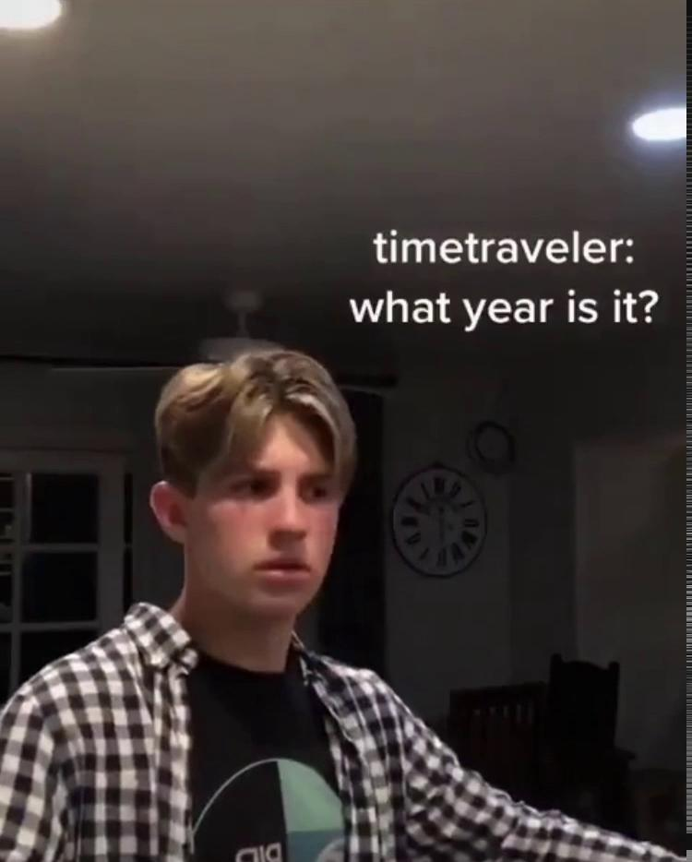
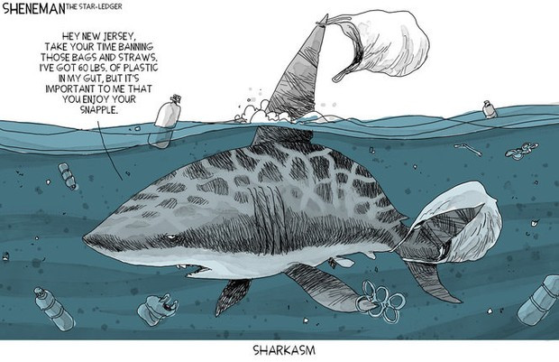
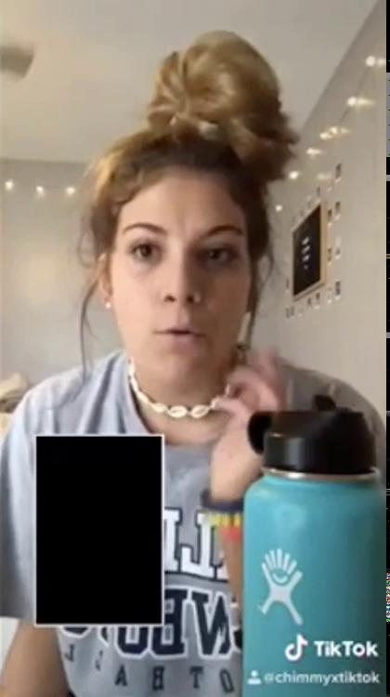
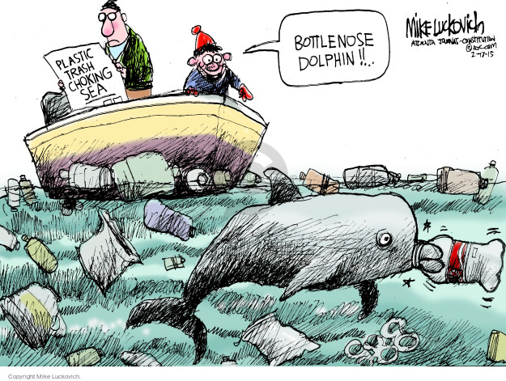
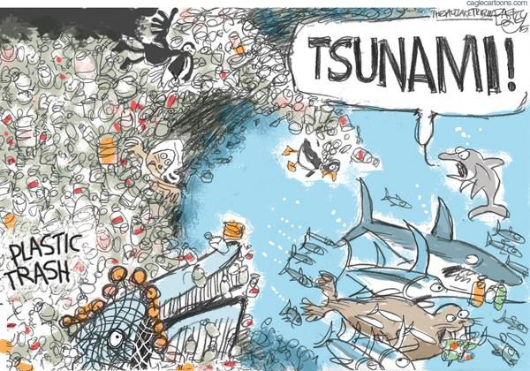
Environment: Plastic Pollution

Slide 22
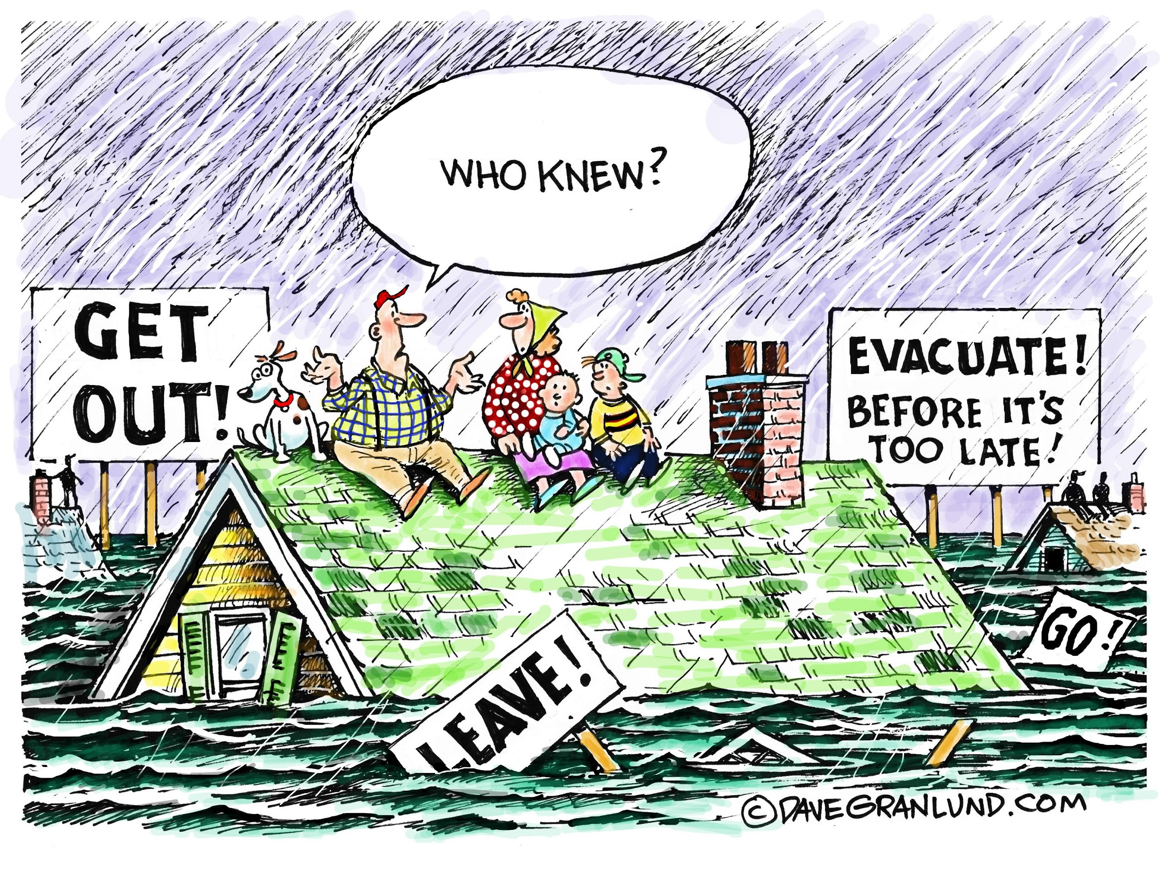
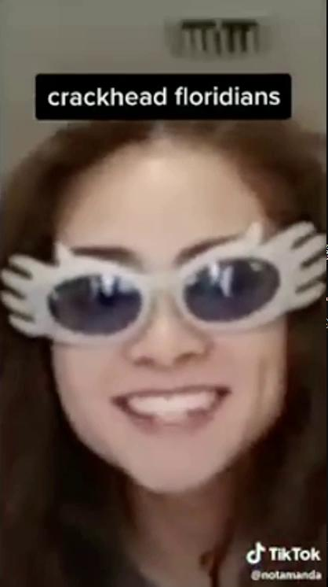
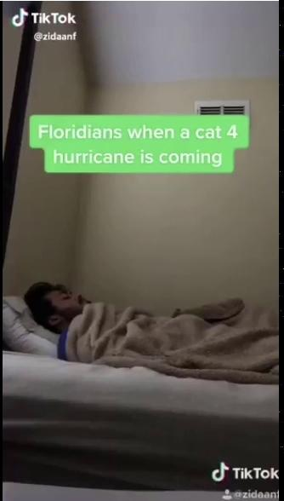
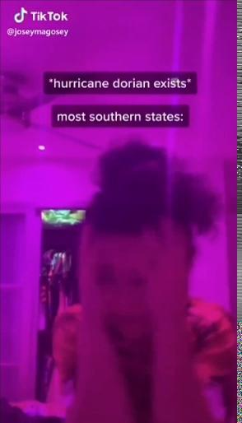
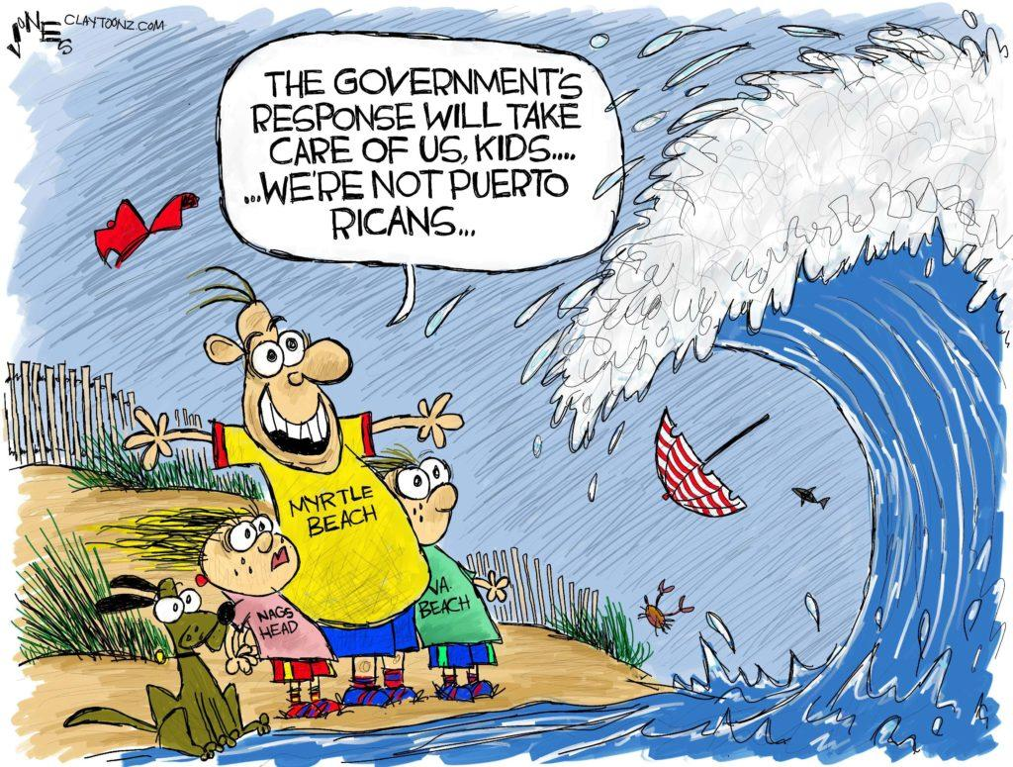
Environmental Disasters: Hurricane Doriane and people not caring to evacuate

Slide 23
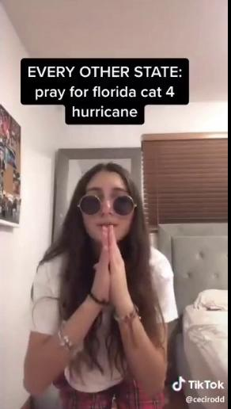
Bonus one (because it couldn’t fit on the previous slide)

Slide 24
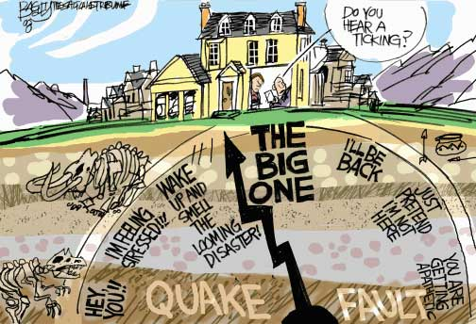
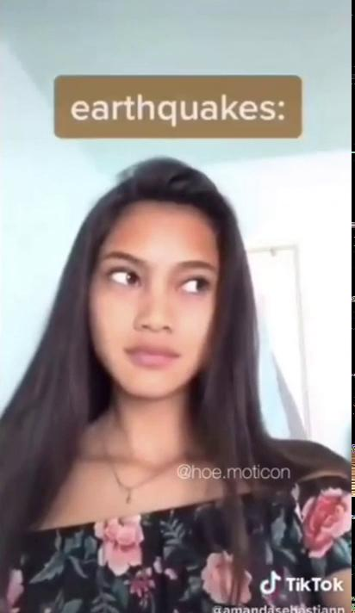
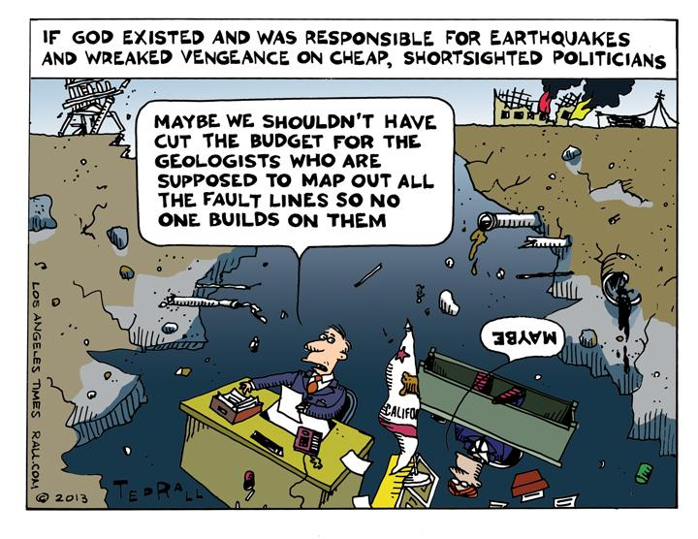
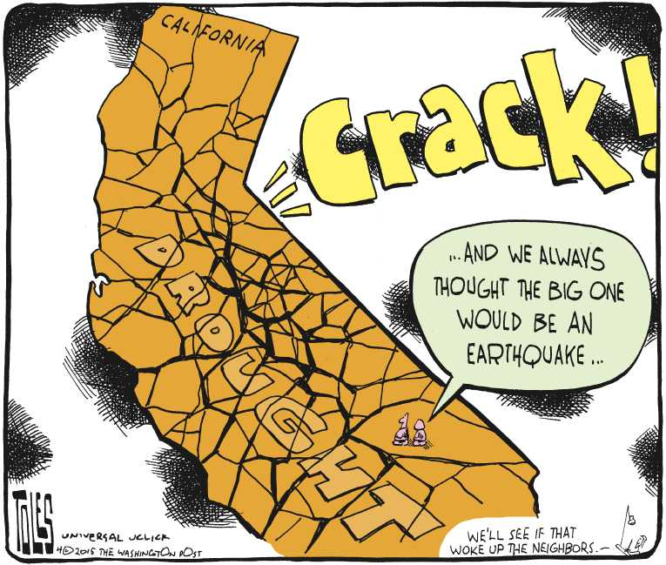
Environmental Disasters: Earthquakes in California

Slide 25
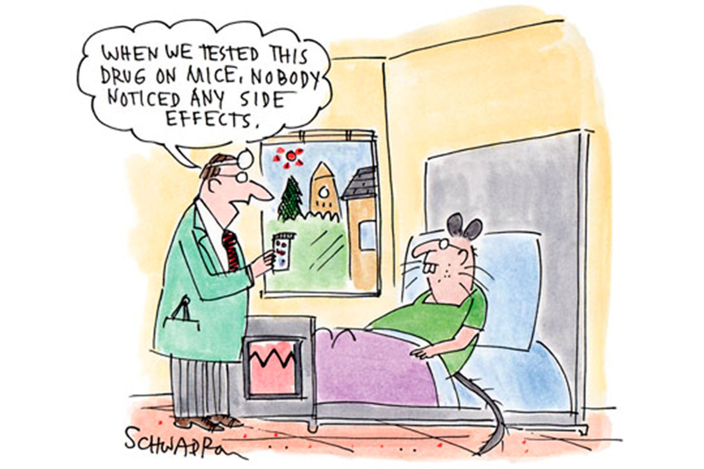
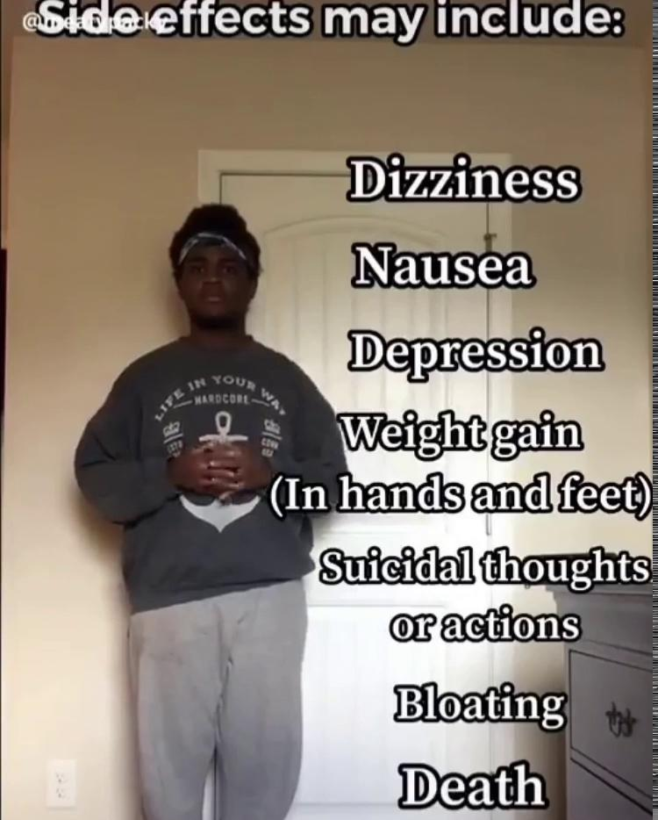
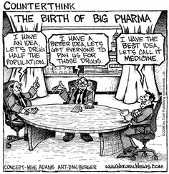
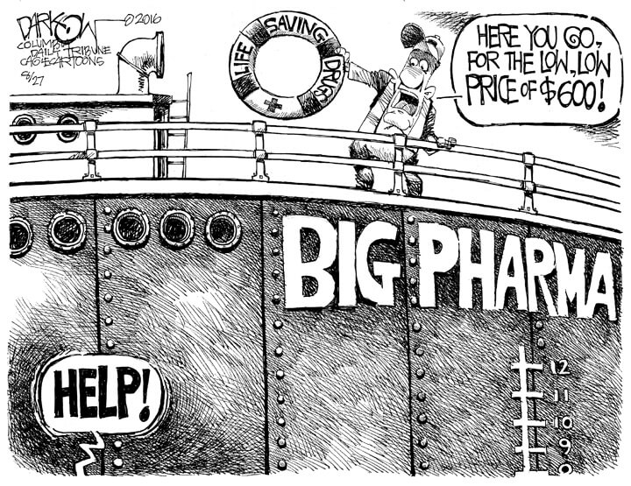
Medicine: Big Pharma and Drug Side Effects

Slide 26
Food: Coke vs Pepsi

Slide 27
Generations
Notes:
Older generations like to make fun of us
But we also like to make fun of ourselves

Slide 28
Internet: Addiction

Slide 29
Internet: Tracking and Mail

Slide 30
Now it’s time to make your own!
You can pair up or work individually
Choose a topic (either from this presentation or your own)
Create either a political cartoon or tiktok
Topics from this presentation:
Environment
Medicine
Internet
Other potential topics:
Gen Z vs Baby boomers
Things ___ like
Fast food
Etc

Slide 31
THE END!

